Slide 1
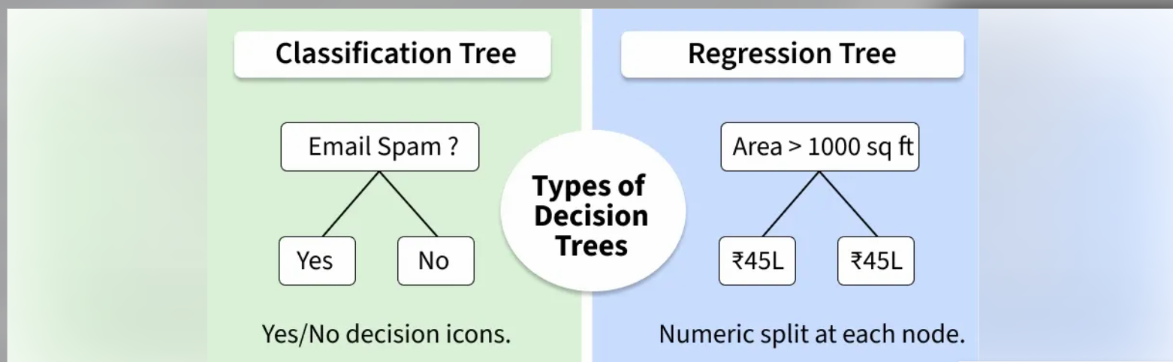







Slide 2
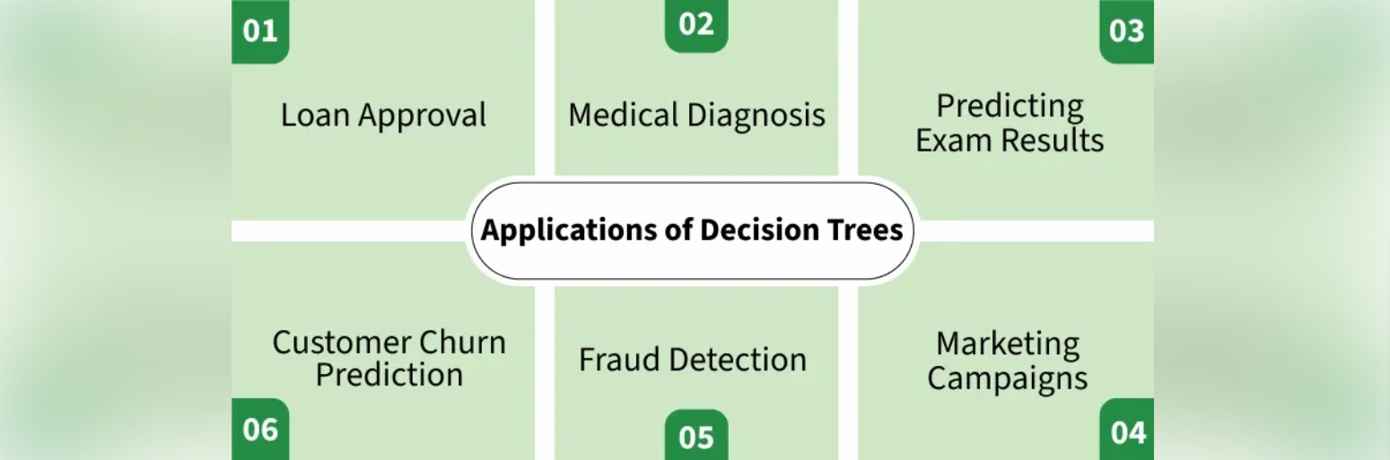




https://www.geeksforgeeks.org/machine-learning/decision-tree/

Slide 3
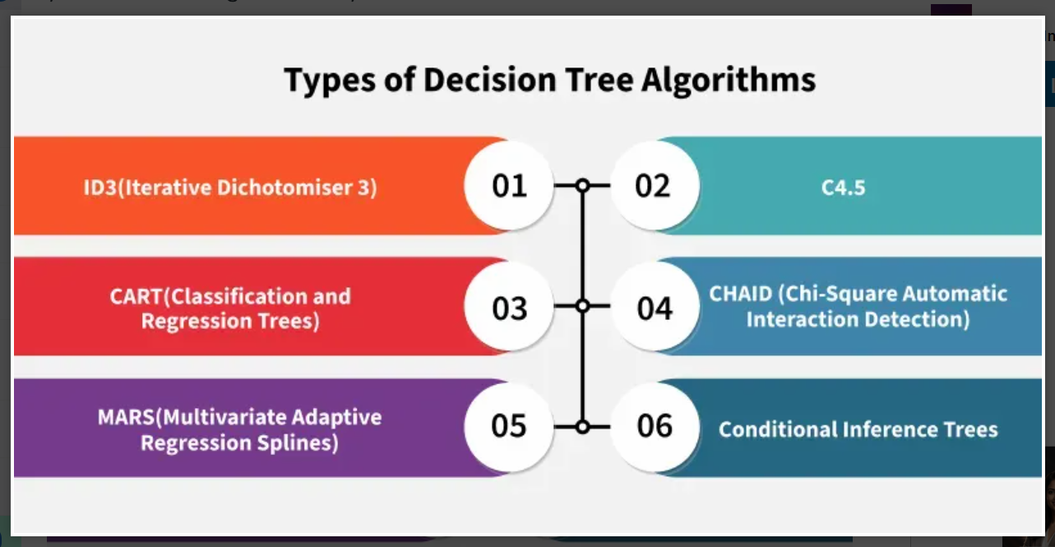
https://www.geeksforgeeks.org/machine-learning/decision-tree-algorithms/

Slide 4














http://geeksforgeeks.org/machine-learning/iterative-dichotomiser-3-id3-algorithm-from-scratch/
https://www.geeksforgeeks.org/machine-learning/implementing-cart-classification-and-regression-tree-in-python/

Slide 5










































Slide 6




















Slide 7
































Slide 8


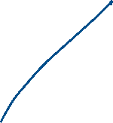





















Outlook | Temperature | Humidity | Wind | Play
Outlook | Temperature | Humidity | Wind | Play Tennis
Sunny | Hot | High | Weak | No
Sunny | Hot | High | Strong | No
Overcast | Hot | High | Weak | Yes
Rain | Mild | High | Weak | Yes
Rain | Cool | Normal | Weak | Yes
Rain | Cool | Normal | Strong | No
Overcast | Cool | Normal | Strong | Yes
Sunny | Mild | High | Weak | No
Sunny | Cool | Normal | Weak | Yes
Rain | Mild | Normal | Weak | Yes
Sunny | Mild | Normal | Strong | Yes
Overcast | Mild | High | Strong | Yes
Overcast | Hot | Normal | Weak | Yes
Rain | Mild | High | Strong | No

Slide 9


















Slide 10
























Slide 11
















Slide 12





























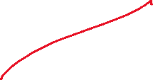





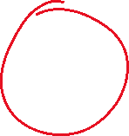

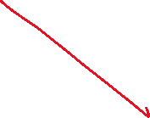



Slide 13






















Slide 14






















Slide 15


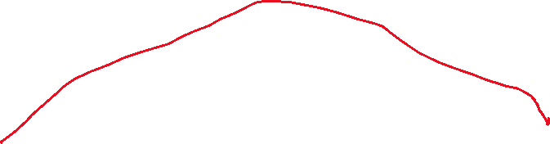






Slide 16
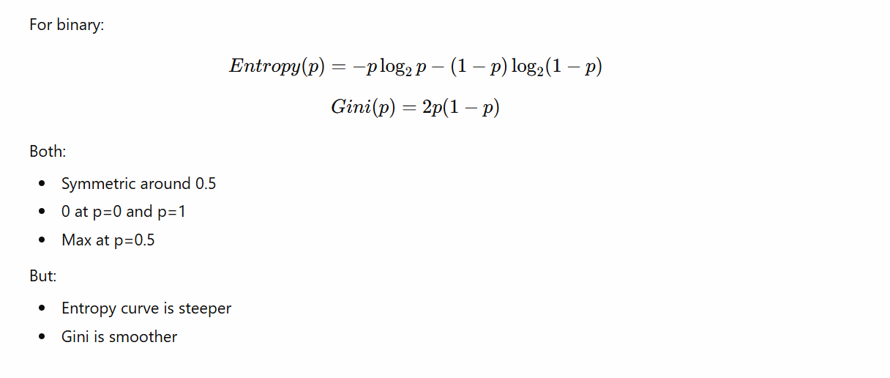

Slide 17
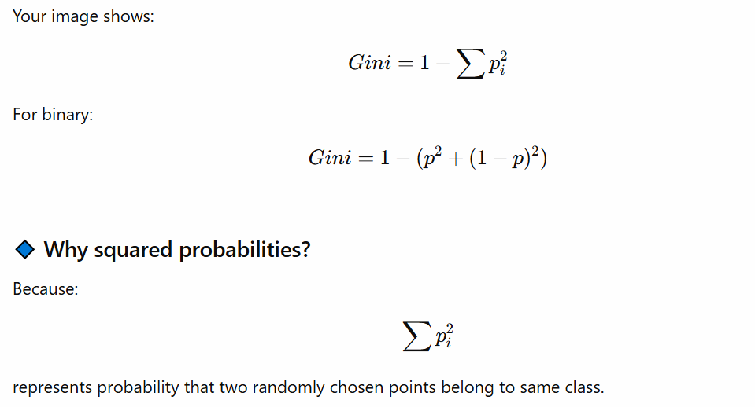
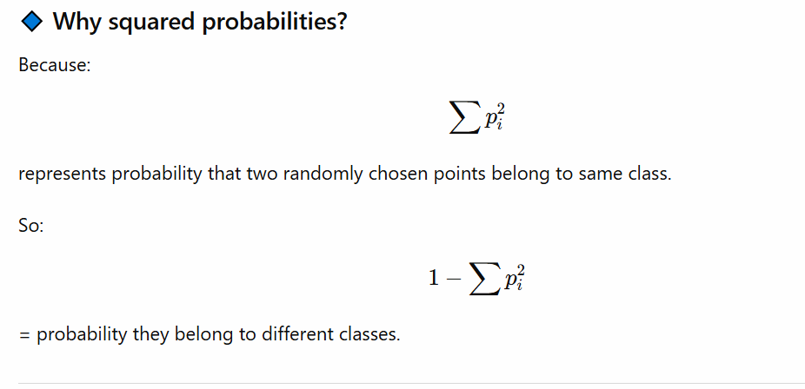
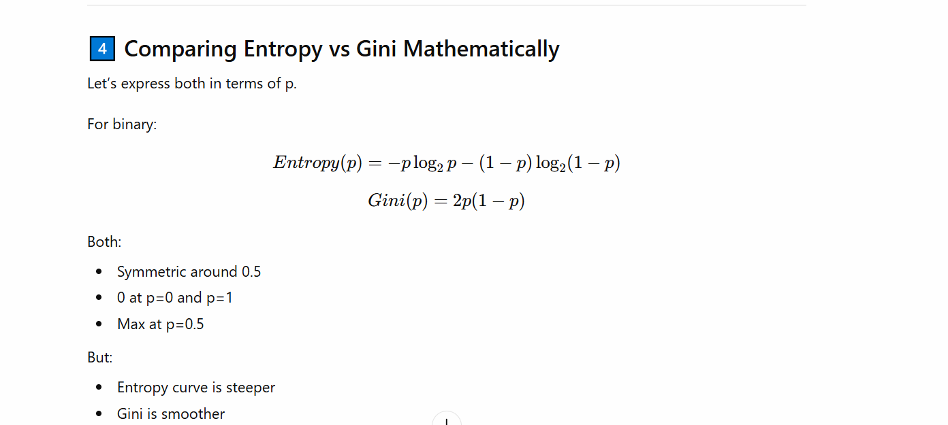

Slide 18






















Slide 19























Slide 20

























https://towardsdatascience.com/decision-trees-explained-entropy-information-gain-gini-index-ccp-pruning-4d78070db36c/

Slide 21





















Slide 22























Slide 23























Slide 24

























Slide 25




















Slide 26





















Slide 27
Outlook | Temperature | Humidity | Wind | Play
Outlook | Temperature | Humidity | Wind | Play Tennis
Sunny | Hot | High | Weak | No
Sunny | Hot | High | Strong | No
Overcast | Hot | High | Weak | Yes
Rain | Mild | High | Weak | Yes
Rain | Cool | Normal | Weak | Yes
Rain | Cool | Normal | Strong | No
Overcast | Cool | Normal | Strong | Yes
Sunny | Mild | High | Weak | No
Sunny | Cool | Normal | Weak | Yes
Rain | Mild | Normal | Weak | Yes
Sunny | Mild | Normal | Strong | Yes
Overcast | Mild | High | Strong | Yes
Overcast | Hot | Normal | Weak | Yes
Rain | Mild | High | Strong | No

Slide 28

















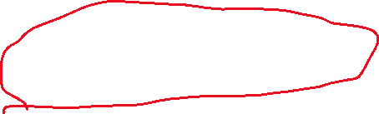




















Slide 29

































Slide 30





































Slide 31






































Slide 32























Slide 33
















Slide 34
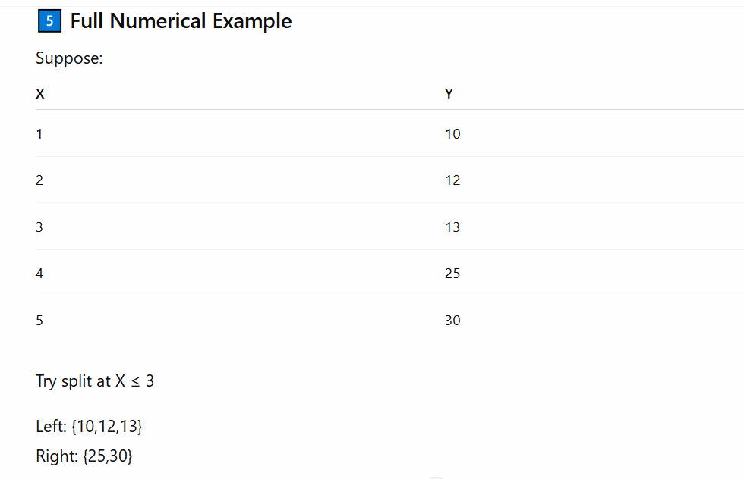

Slide 35
















Slide 36







Slide 37

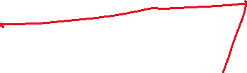




























Slide 38

































Slide 39






























Slide 40

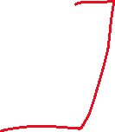



















Slide 41






























Slide 42




























Slide 43




























Slide 44
























Slide 45

























Slide 46





